Slide 1
Life In Pain
By: Madelyn Novak
Scene: 7

Slide 2
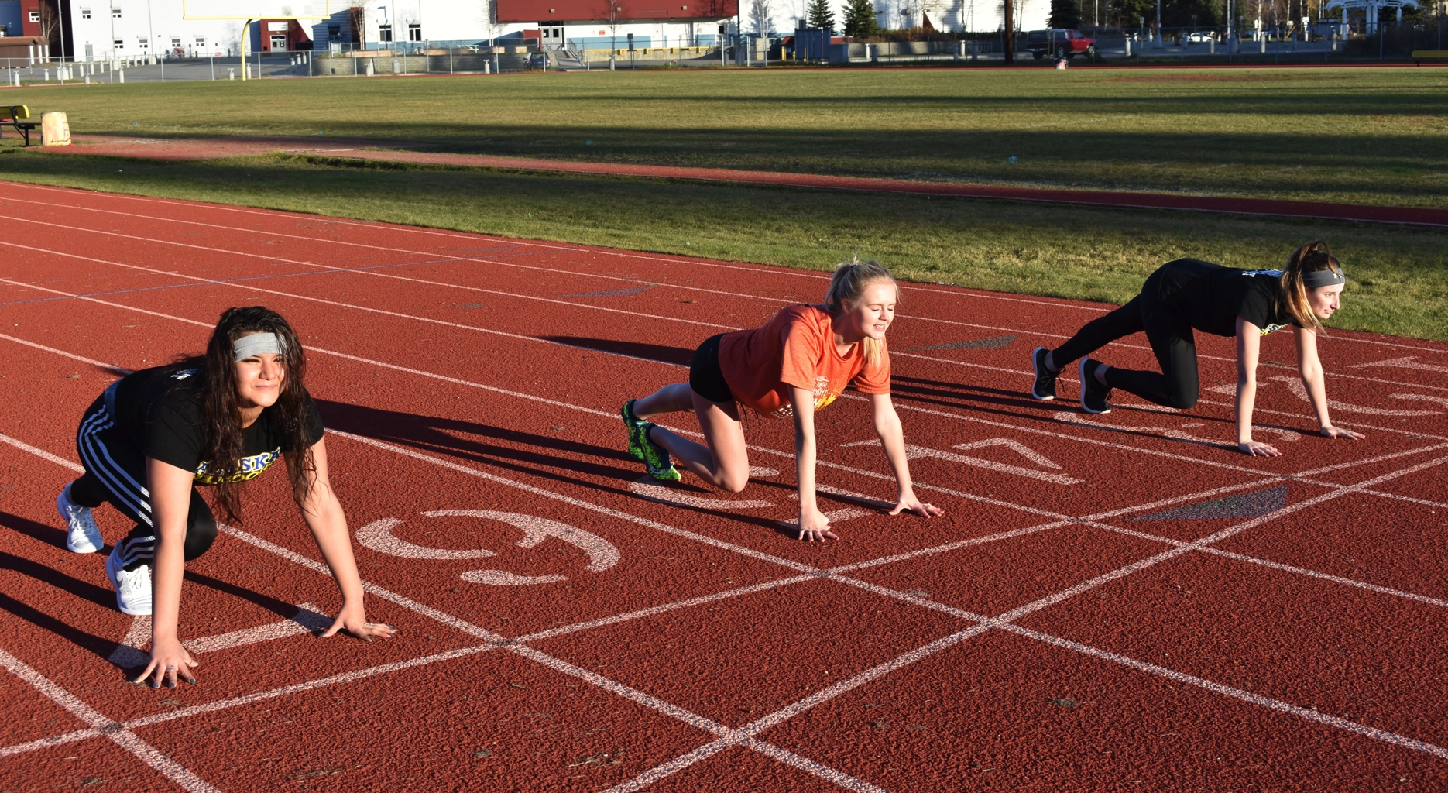
The cross country team gets in ready position on the track.

Slide 3
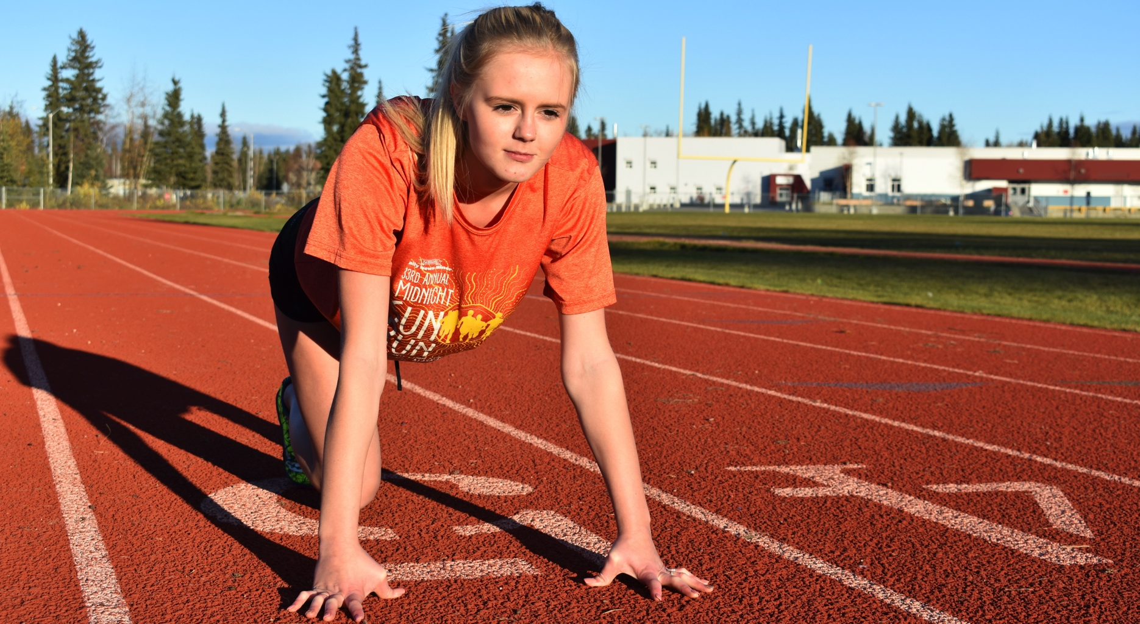
The cross country team gets in ready position on the track.

Slide 4
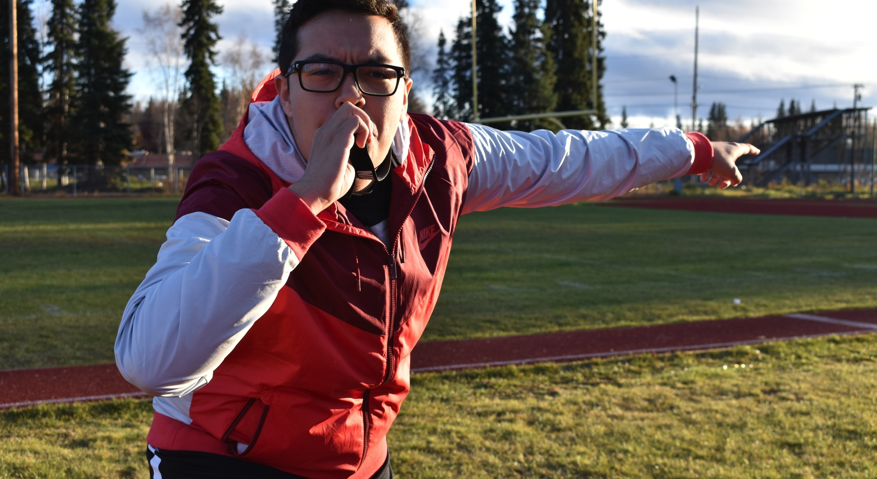
Ok ladies! One more day, show me what you got!
The coach blows the whistle

Slide 5
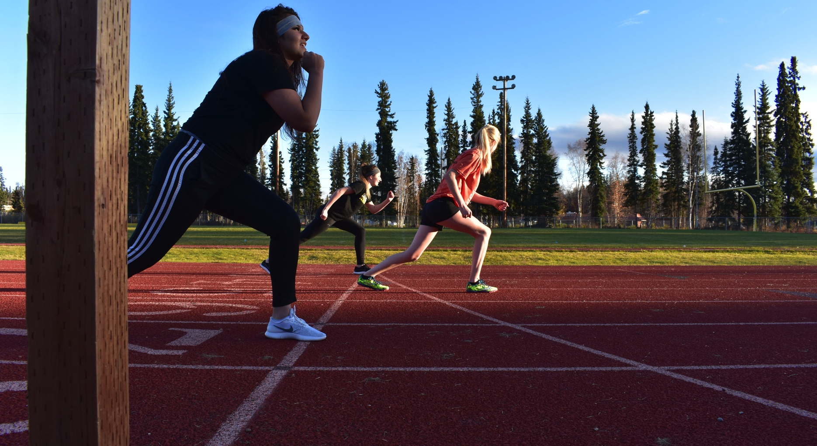
and the ladies start running.

Slide 6
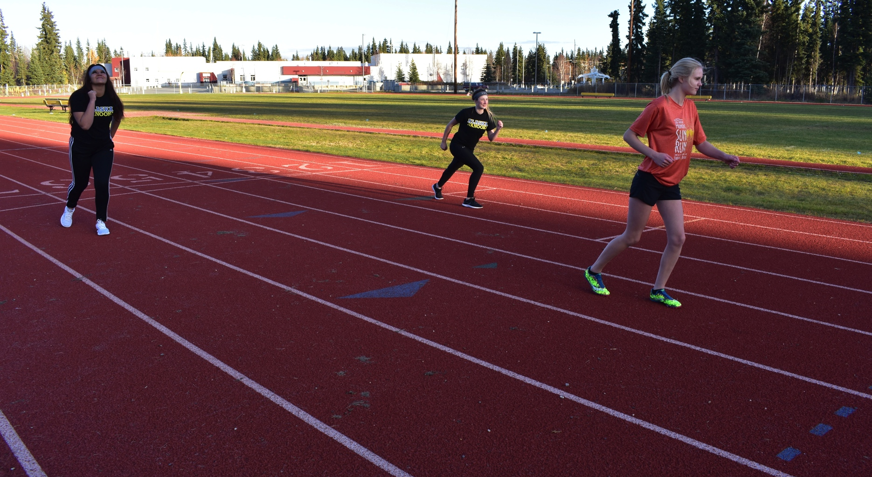
Jessica speeds past everyone.

Slide 7
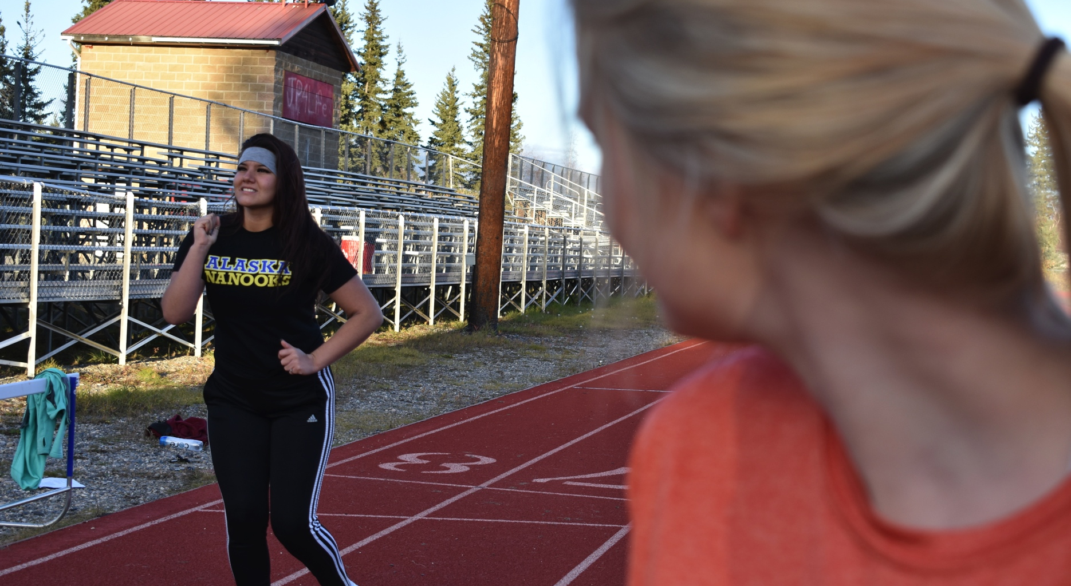
Jessica smiles back at the girls

Slide 8
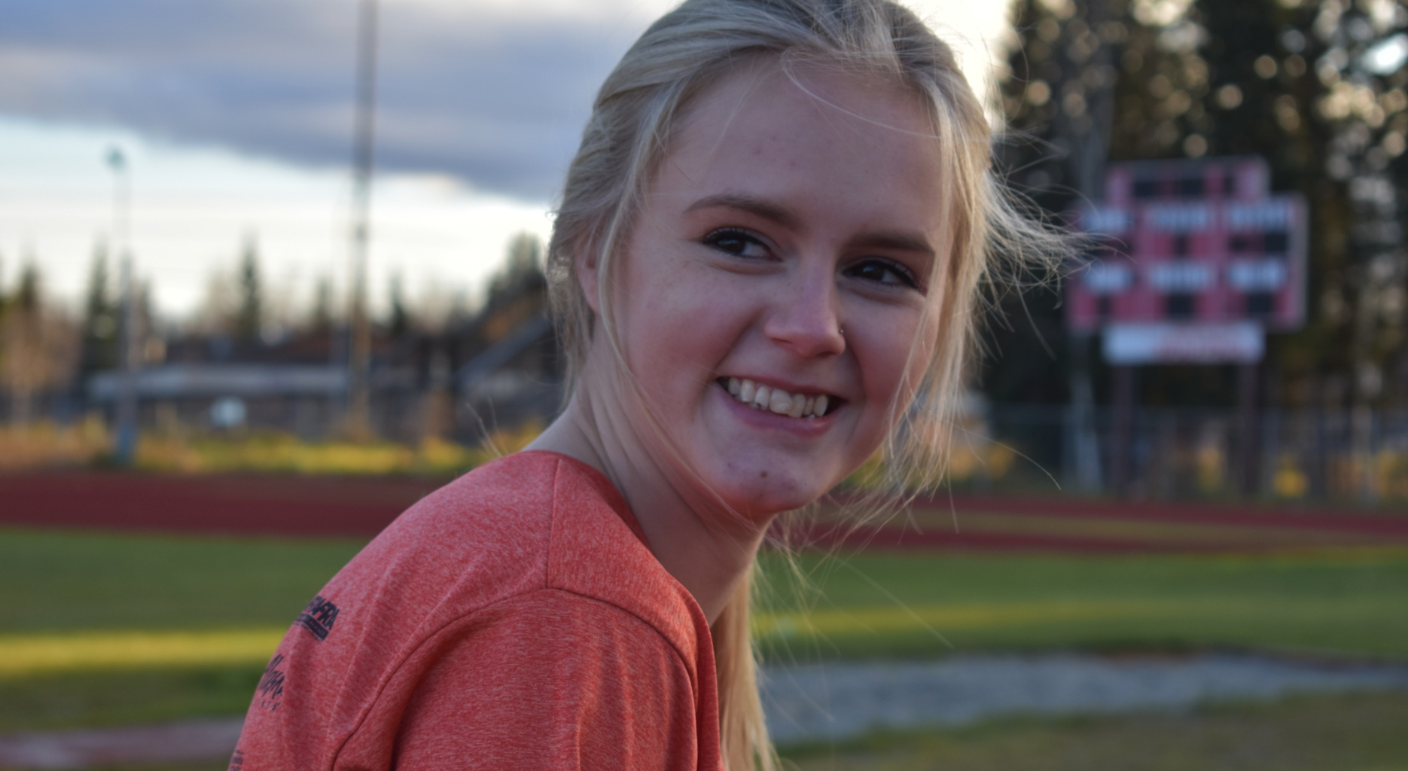
Jessica smiles back at the girls

Slide 9
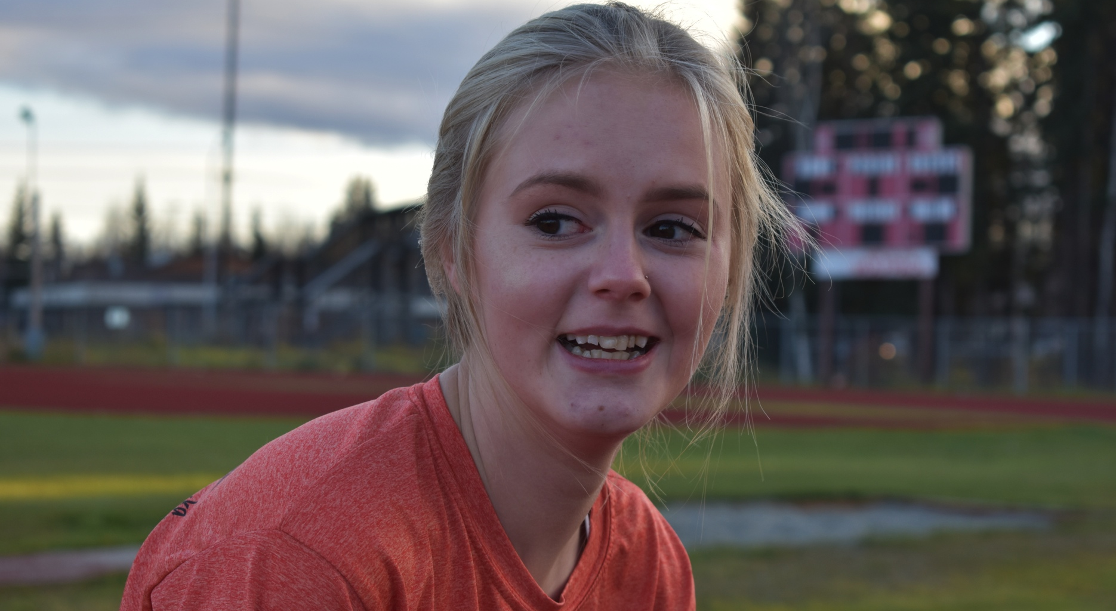
then her smile vanished just as fast

Slide 10
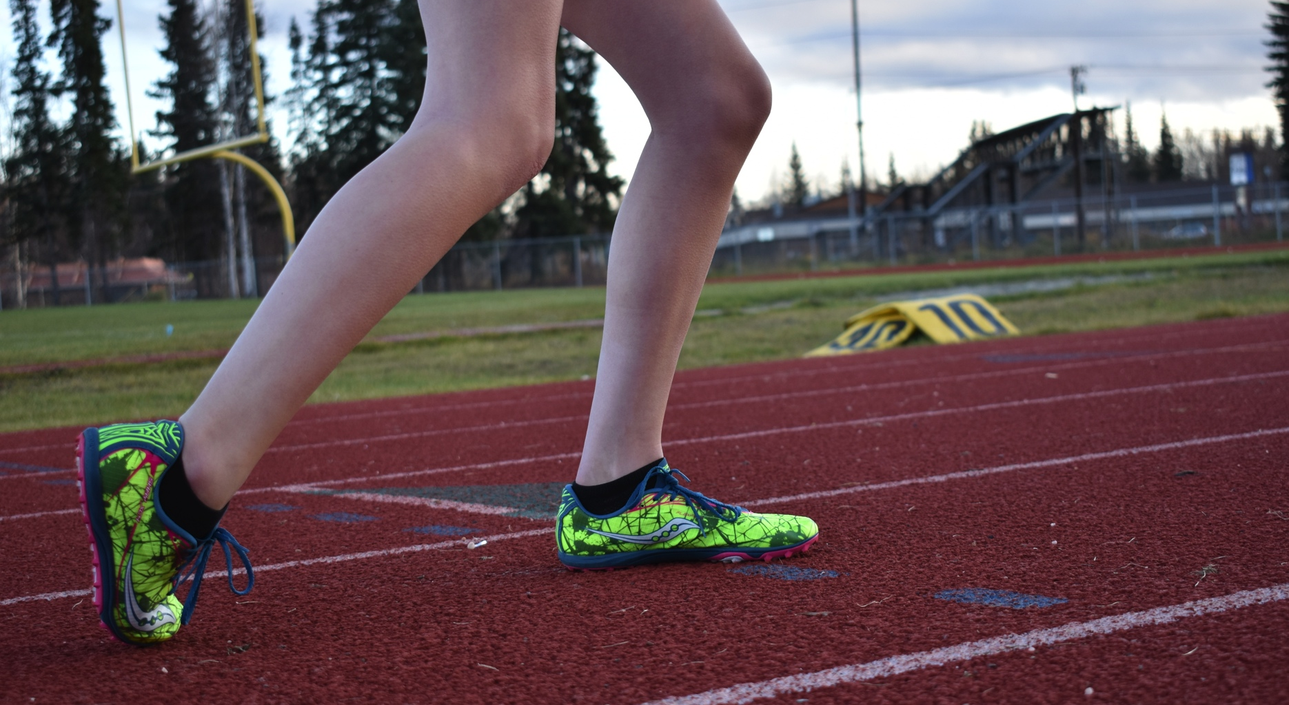
Jessica’s legs went numb

Slide 11
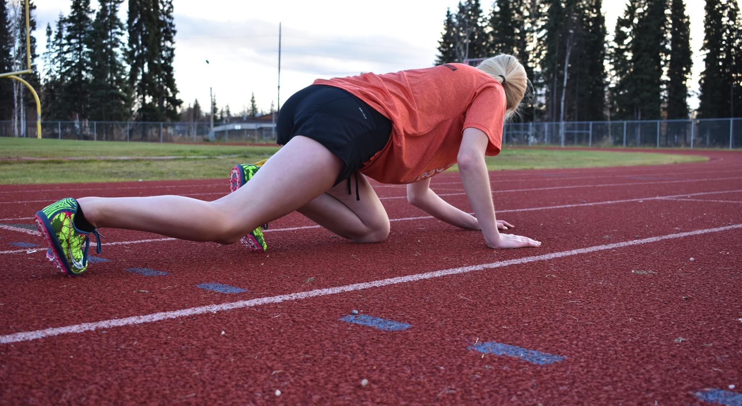
and she collapsed on the track.

Slide 12
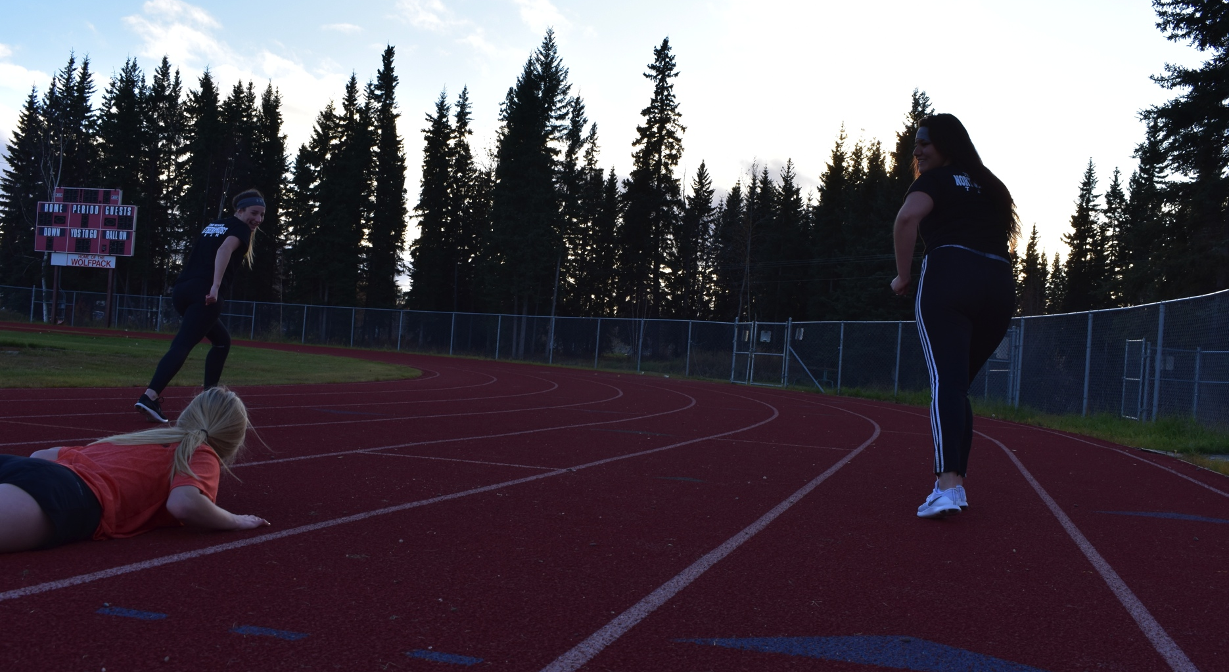
The girls ran past her and laughed.

Slide 13
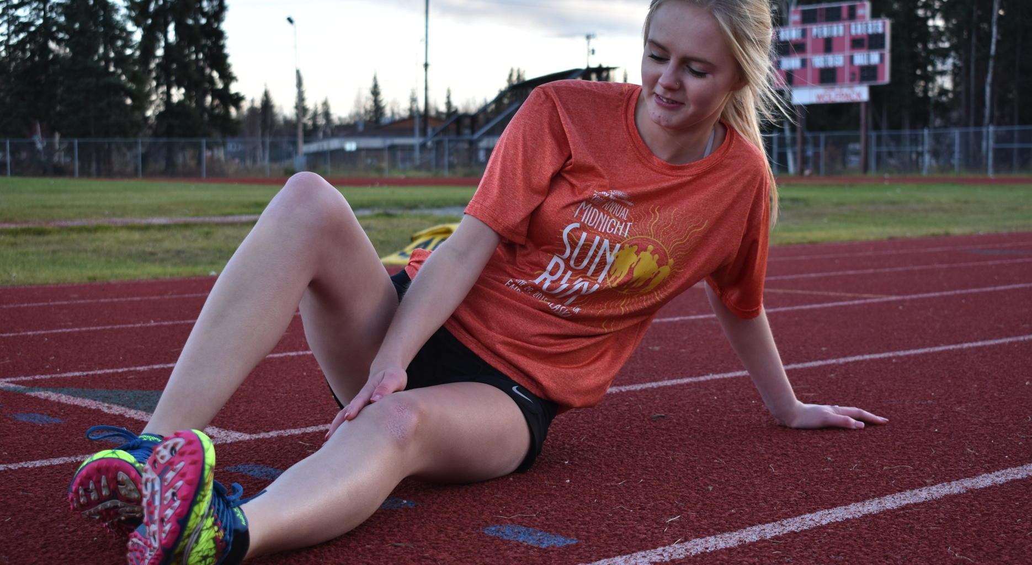
Jessica looked at her legs in shock

Slide 14
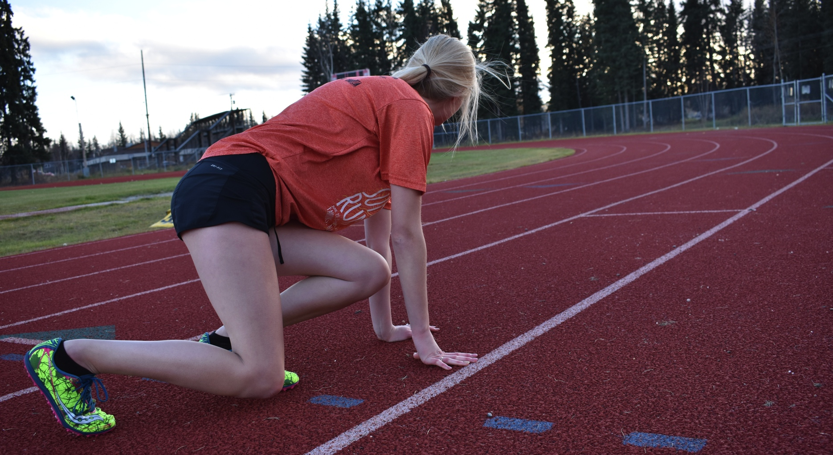
and got back up to start running.

Slide 15
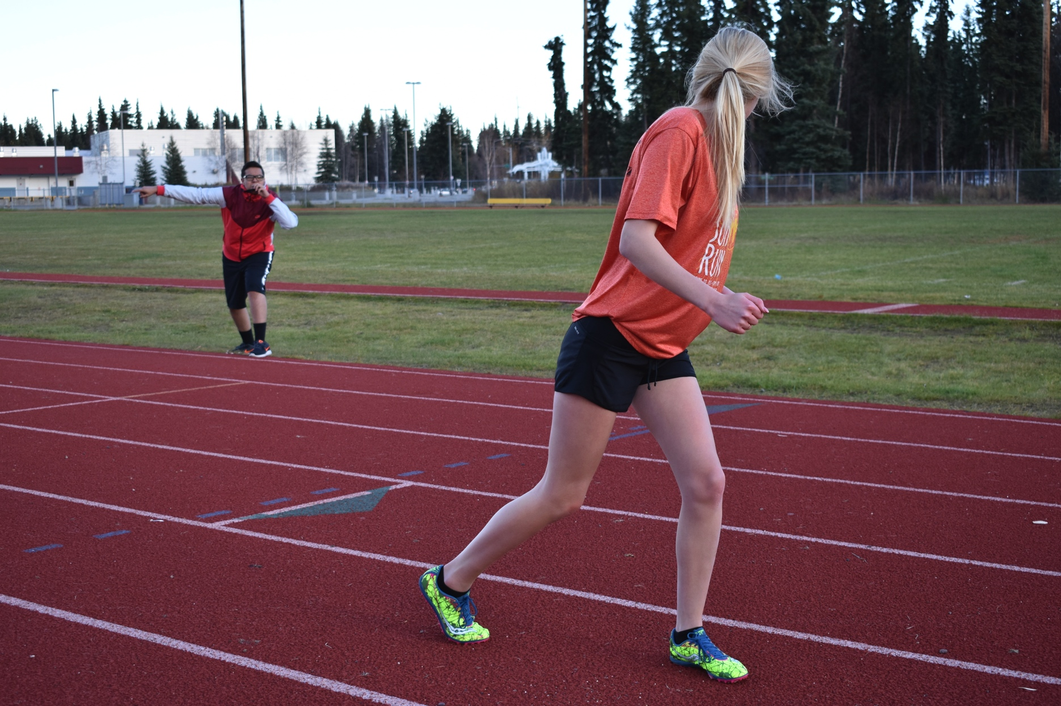
COACH: Jessica! Go sit on the side!

Slide 16
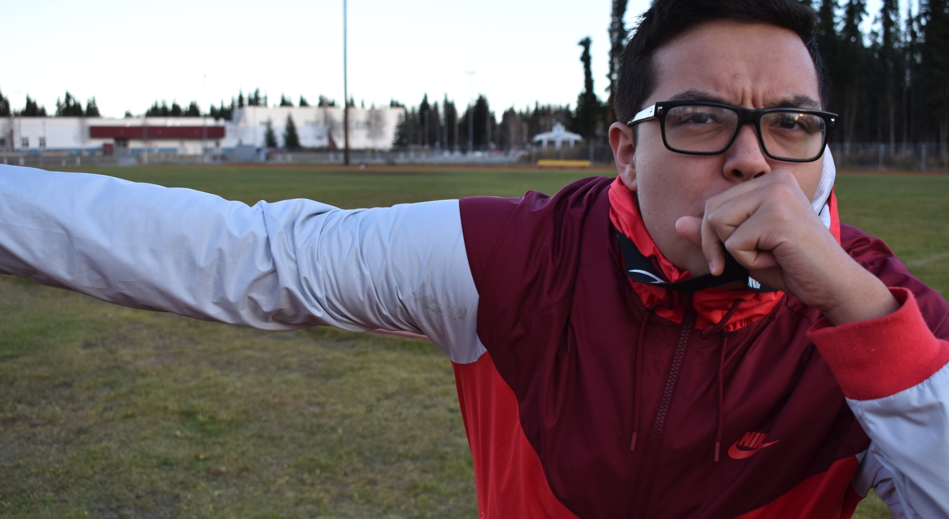
COACH: Jessica! Go sit on the side!

Slide 17
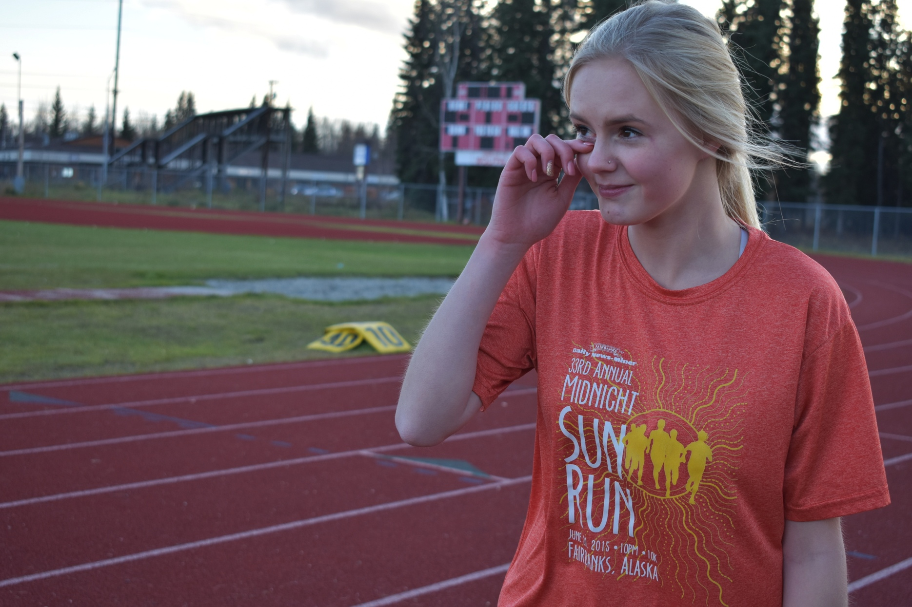
Jessica’s face turns bright red and she limps over to the sideline, with her eyes full of water.

Slide 18
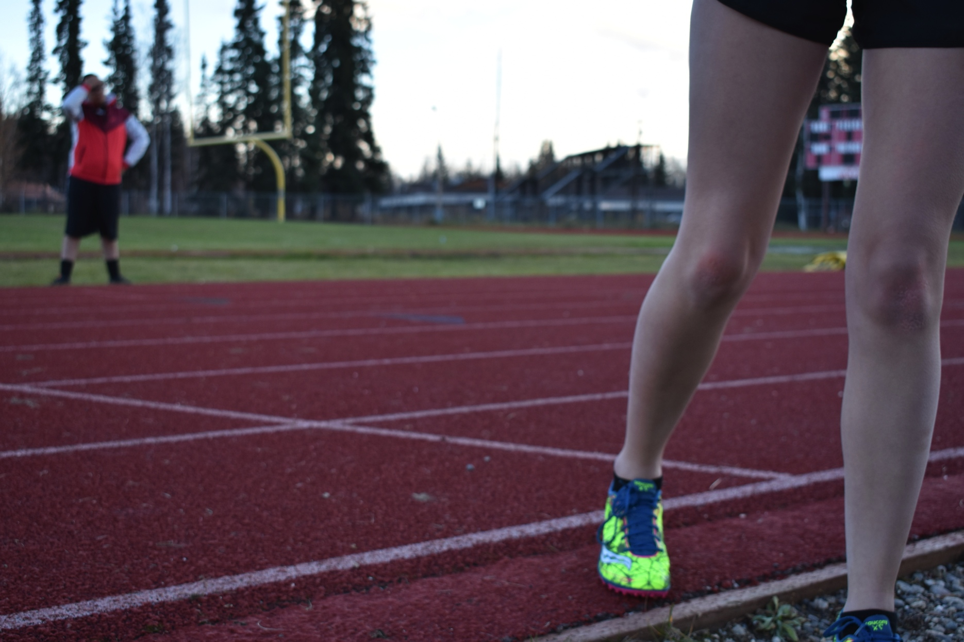
Jessica’s face turns bright red and she limps over to the sideline, with her eyes full of water.

Slide 19
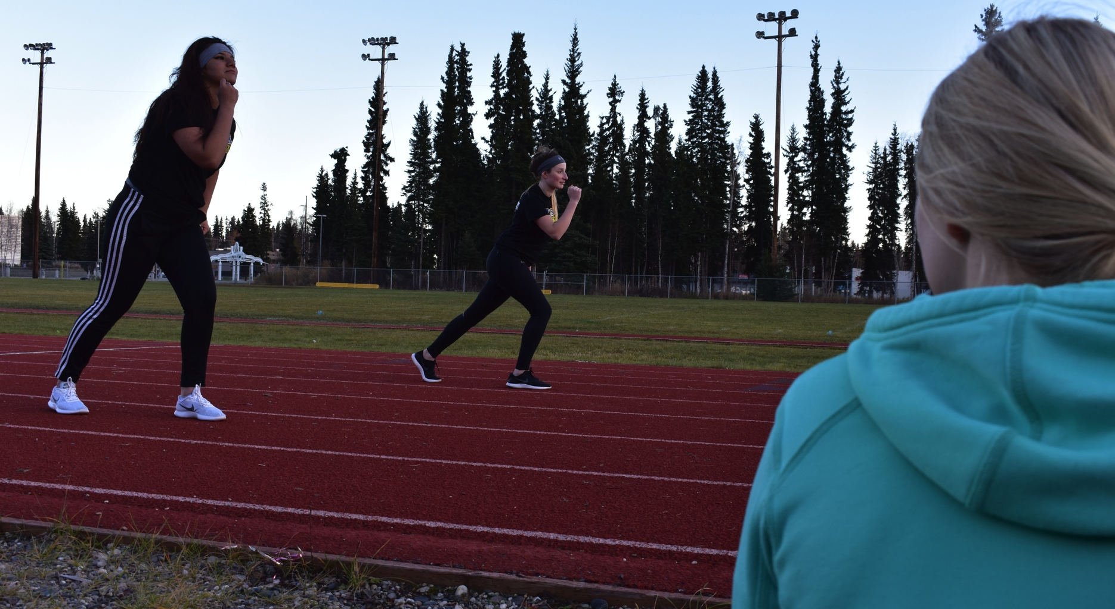
Jessica watched as the girls ran the rest of practiced.

Slide 20
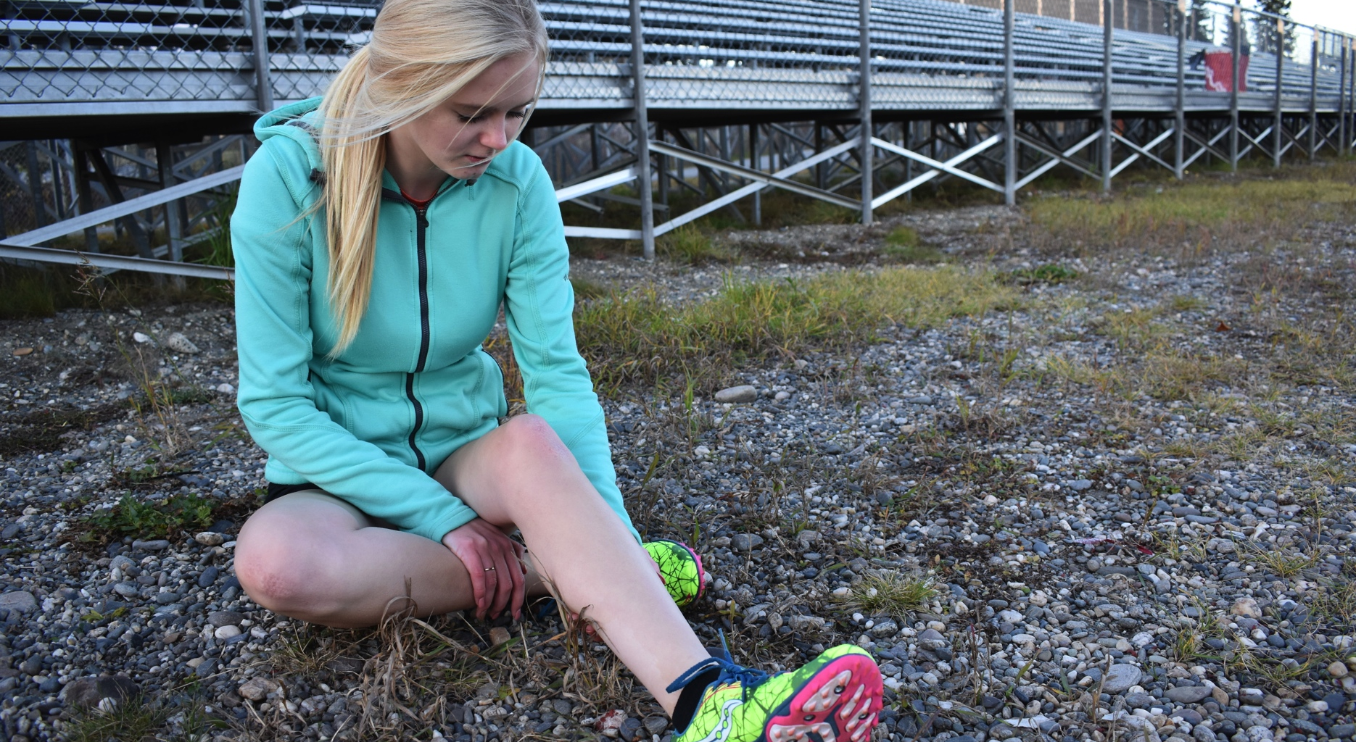
Jessica’s legs throbbing in pain.

Slide 21
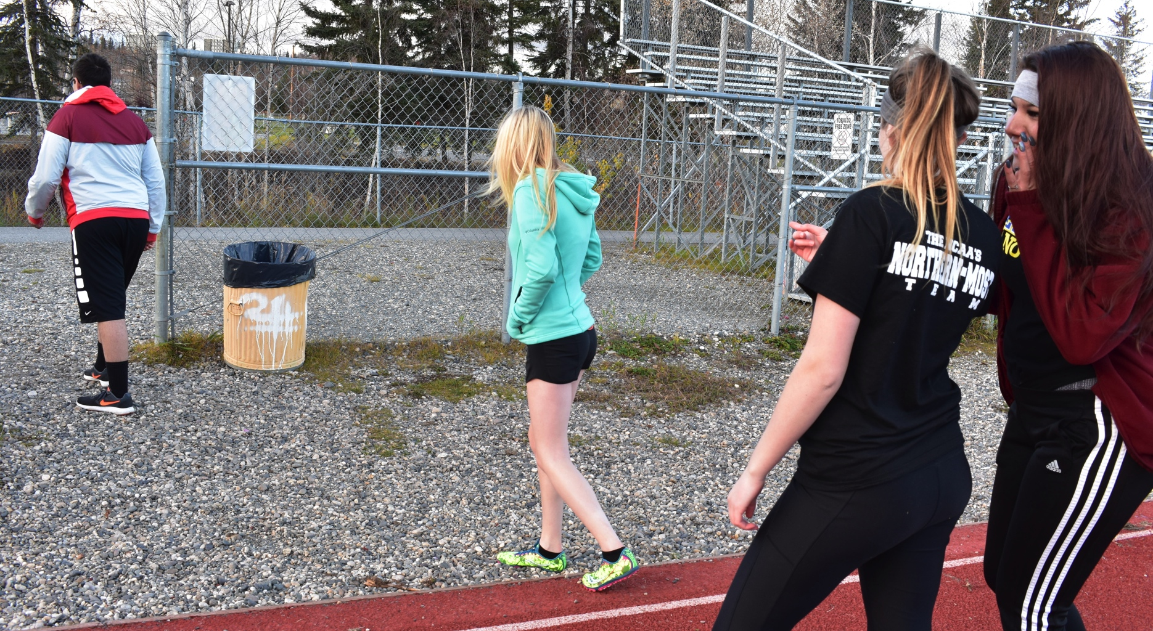
Practice was over and Jessica limped to the parking lot. Her head looking down in shame.

Slide 22
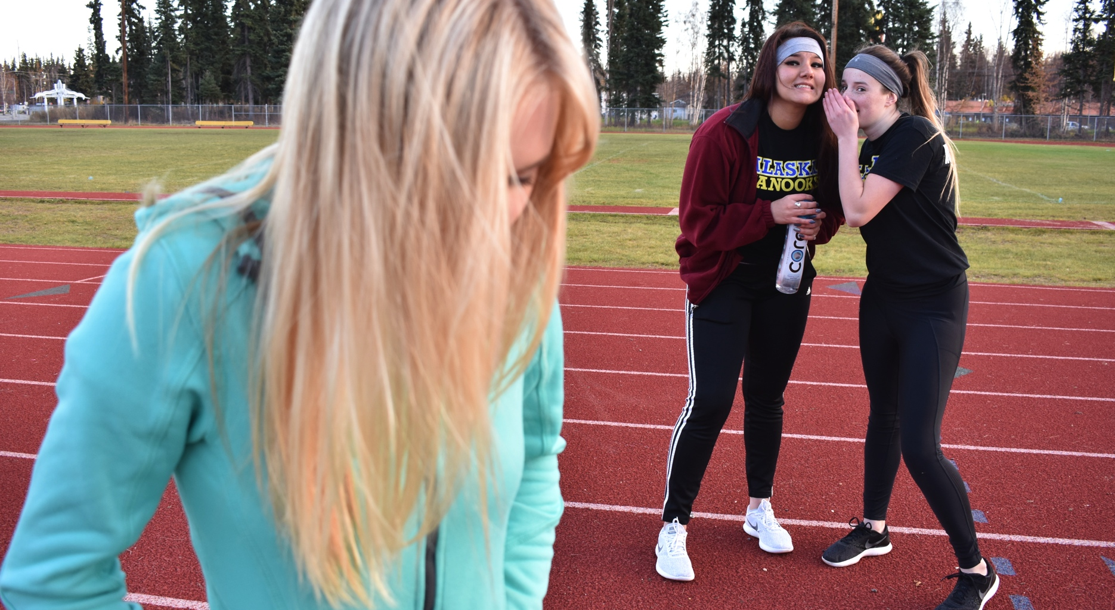
Practice was over and Jessica limped to the parking lot. Her head looking down in shame.

Slide 23
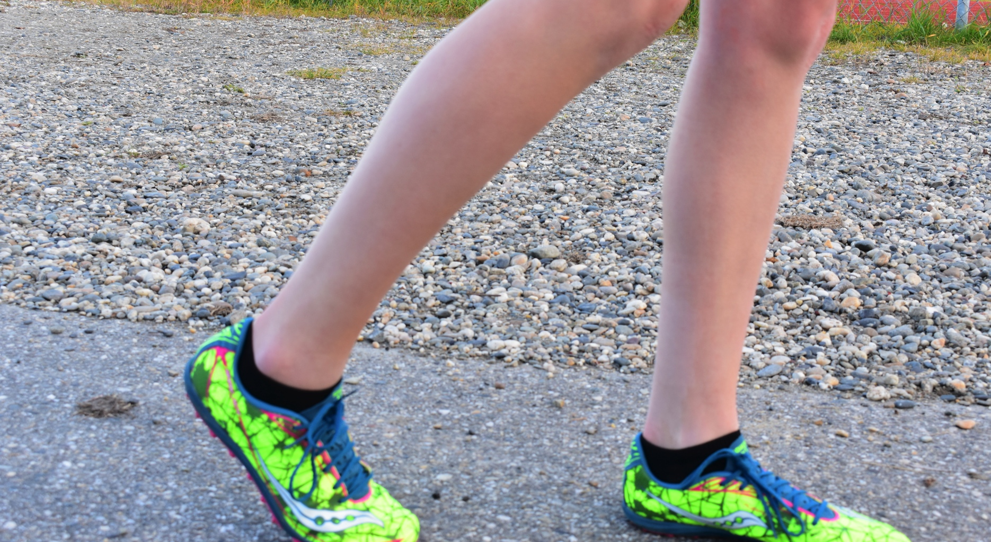
Practice was over and Jessica limped to the parking lot. Her head looking down in shame.

Slide 24
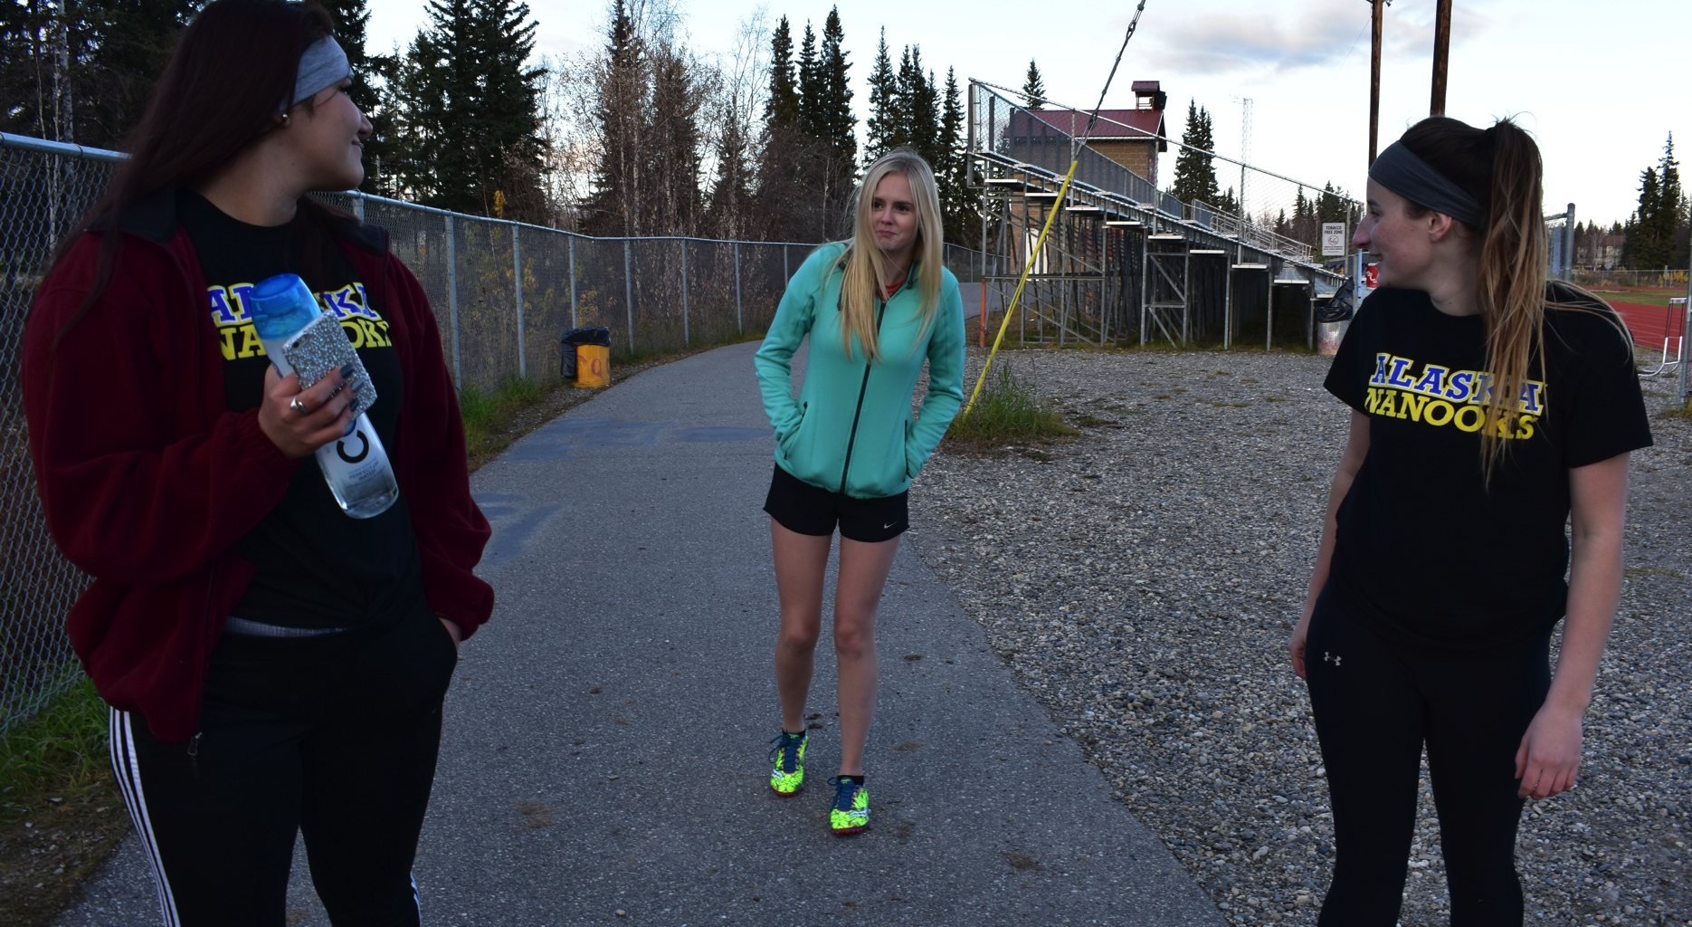
Her teammates walked past her.

Slide 25
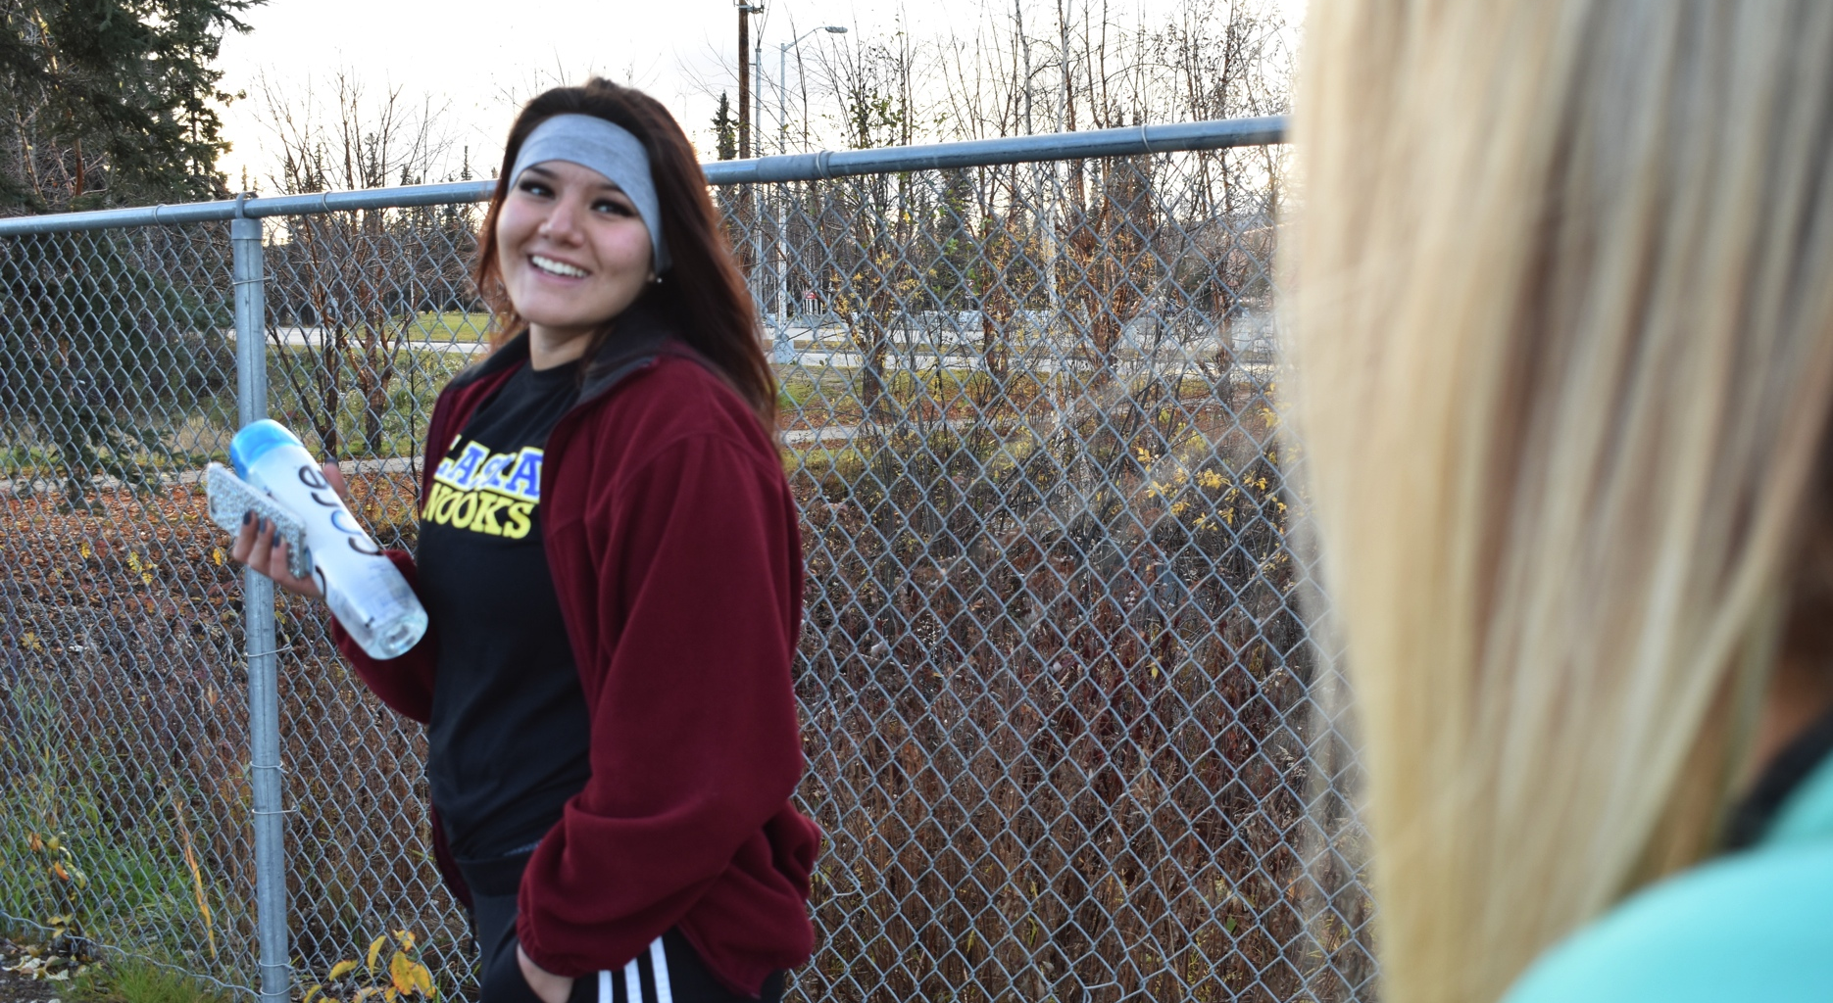
TEAMMATE 1: I wonder if I could get out of running too if I pretended to collapsed on the track.

Slide 26
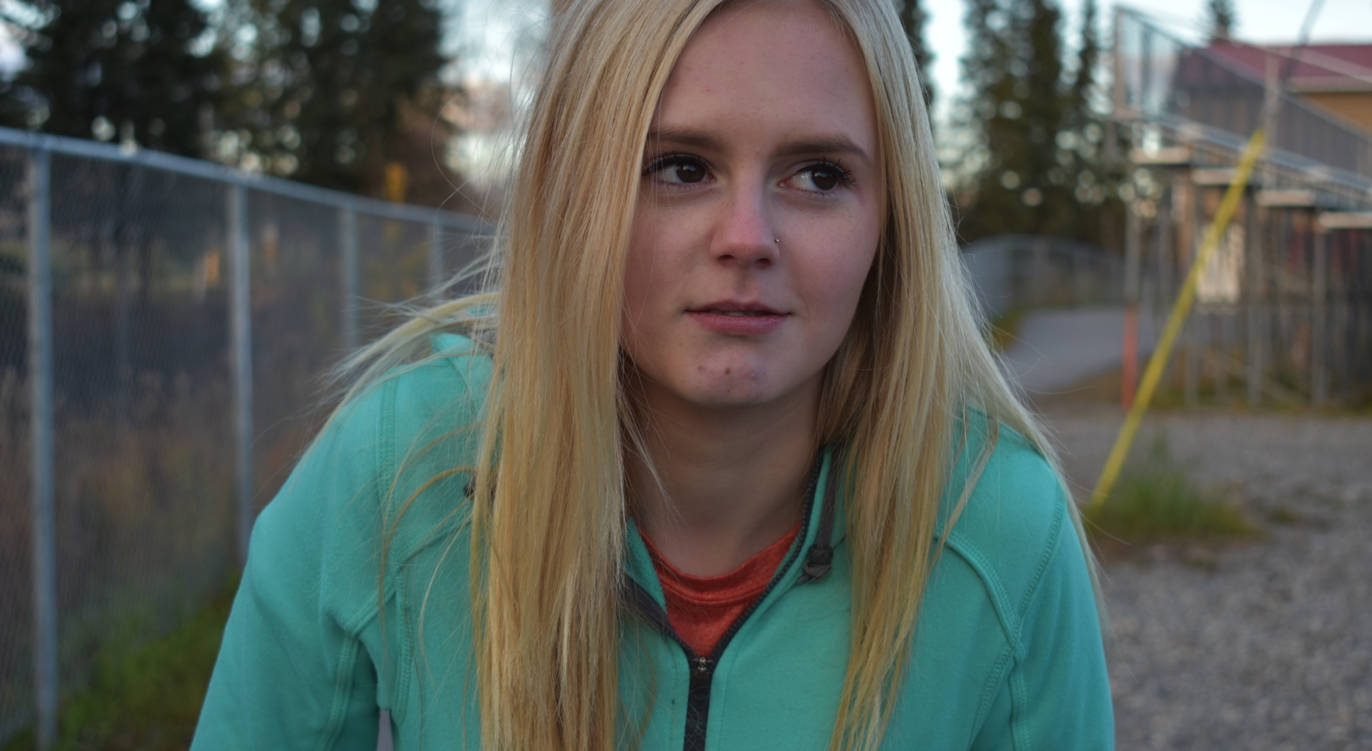
The girls walked away laughing as Jessica slowly limped behind them with tears rolling down her face.

